Slide 1
1. Introduction to Neural Networks
1.1 What is a neural network?
1.2 Biological neural networks
1.3 Human nervous system
1.4 Artificial neural networks
1.5 Benefits of neural networks
1.6 Brief history of neural networks
1.7 Applications of neural networks

Slide 2
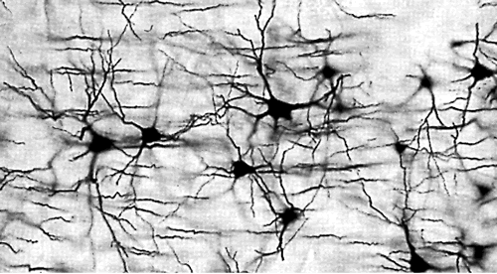
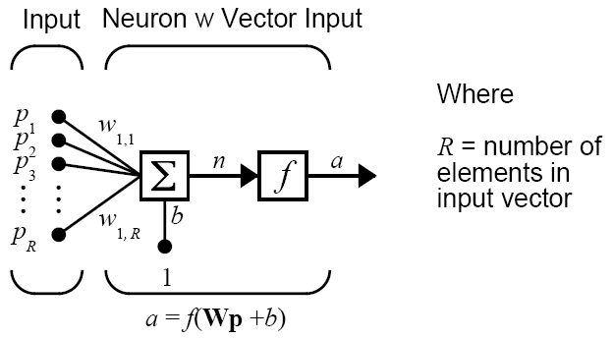
1.1 What is a neural network?
Neural network
Network of biological neurons
Biological neural networks are made up of real biological neurons that are connected or functionally related in the peripheral nervous system or the central nervous system
Artificial neurons
Simple mathematical approximations of biological neurons
Notes:
Text source: Haykin 1.1
Image source: https://www.pinterest.com/pin/110408628337237668/

Slide 3
What is a neural network?
Artificial neural networks
Networks of artificial neurons
Very crude approximations of small parts of the biological brain
Implemented as software or hardware
By “Neural Networks” we usually mean Artificial Neural Networks

Slide 4
Neural network definitions
Zurada (1992)
Artificial neural systems, or neural networks, are physical cellular systems which can acquire, store, and utilize experiential knowledge.
Haykin (1999)
A neural network is a massively parallel distributed processor that has a natural propensity for storing experiential knowledge and making it available for use. It resembles the brain in two respects:
Knowledge is acquired by the network through a learning process.
Interneuron connection strengths known as synaptic weights are used to store the knowledge.

Slide 5
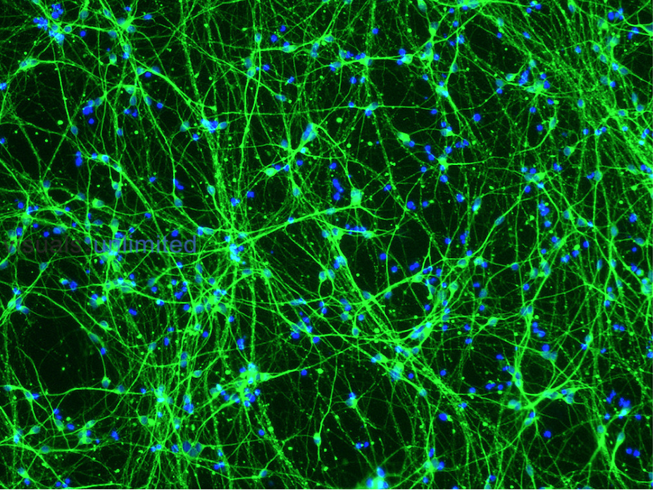
1.2 Biological neural networks
Cortical neurons (nerve cells) growing in culture
Neurons have a large cell body with several long processes extending from it, usually one thick axon and several thinner dendrites
Dendrites receive information from other neurons
Axon carries nerve impulses away from the neuron. Its branching ends make contact with other neurons and with muscles or glands
This complex network forms the nervous system, which relays information through the body
Human neurons derived from IPSC stem cells
Notes:
Text source: Haykin 1.2
Image source: https://visualsunlimited.photoshelter.com/search/result/I000068ogn0.N78I
Human neurons derived from IPSC stem cells

Slide 6
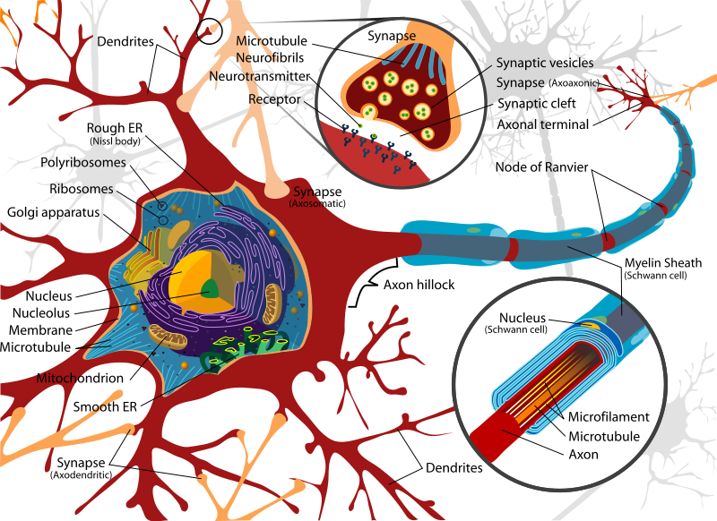
Biological neuron
Notes:
Image source: https://commons.wikimedia.org/wiki/File:Complete_neuron_cell_diagram_en.svg

Slide 7
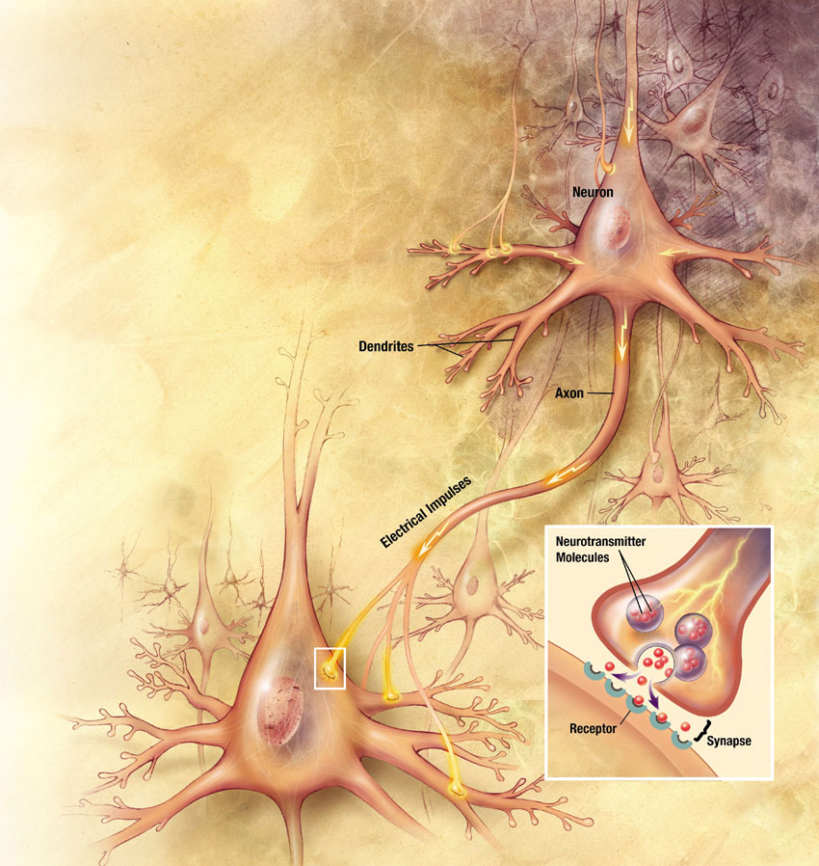
Interaction of neurons
Action potentials arriving at the synapses stimulate currents in its dendrites
These currents depolarize the membrane at its axon, provoking an action potential
Action potential propagates down the axon to its synaptic knobs, releasing neurotransmitters and stimulating the post-synaptic neuron (lower left)
Notes:
Image source: https://commons.wikimedia.org/wiki/File:Neurons_big1.jpg

Slide 8
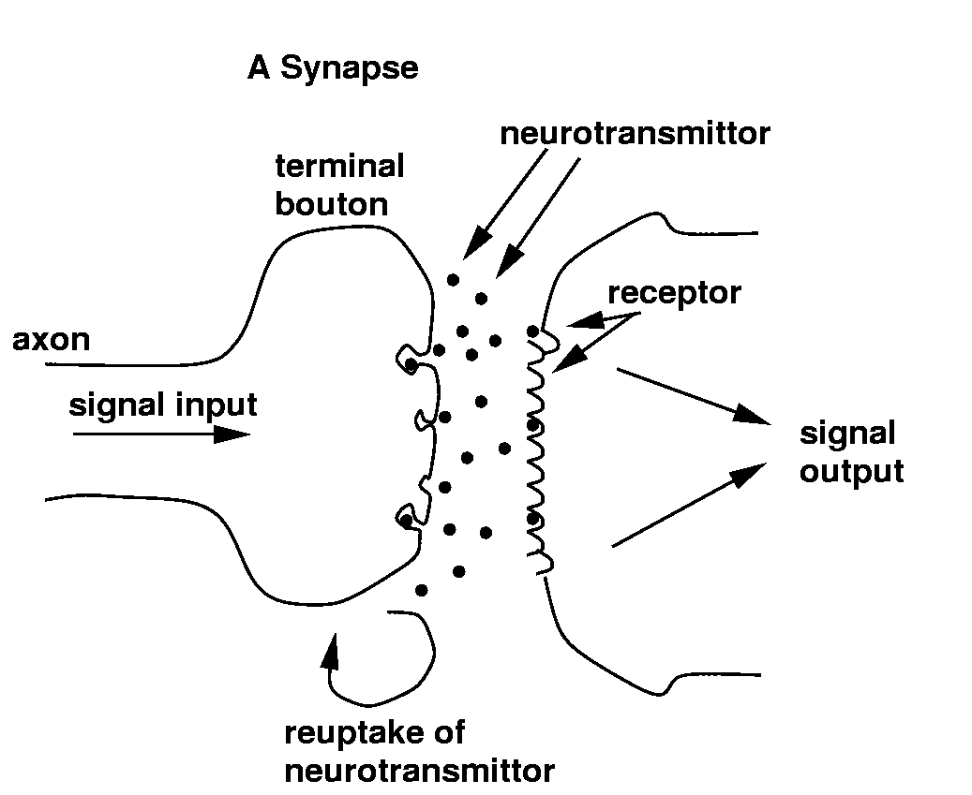

Synapses
Elementary structural and functional units that mediate the interaction between neurons
Chemical synapse: pre-synaptic electric signal → chemical neurotransmitter → post-synaptic electrical signal
Notes:
Image source: https://fineartamerica.com/featured/excitatory-synapse-cns-dennis-kunkel-microscopyscience-photo-library.html

Slide 9
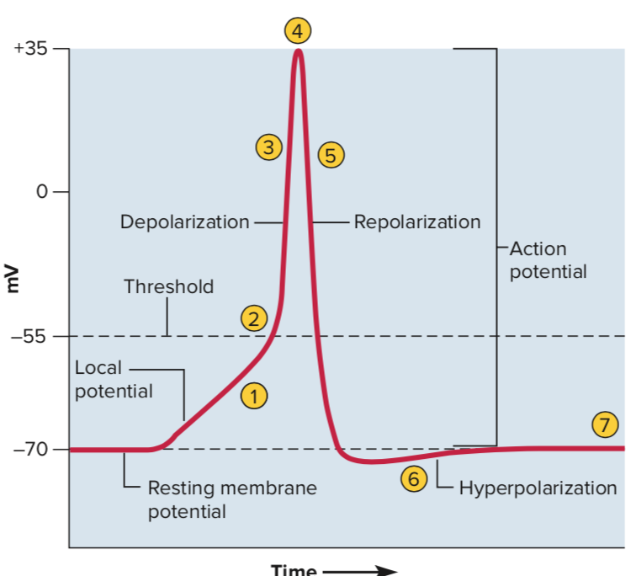
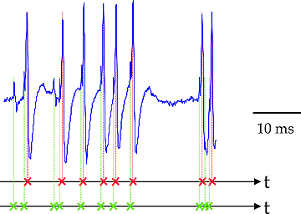
Action potential
Spikes or action potential
Neurons encode their outputs as a series of voltage pulses
Axon is very long, high resistance & high capacity
Frequency modulation → Improved signal/noise ratio
Notes:
Image source: https://qph.fs.quoracdn.net/main-qimg-0d6bec93a41ce0a8b4203b90f4d67545
Image source: https://dhj.rice.edu/action-potential/

Slide 10
1.3 Human nervous system
Human nervous system can be represented by three stages:
Receptors
collect information from the environment (photons on the retina, tactile info, ...)
Effectors
generate interactions with the environment (muscle activation, ...)
Flow of information
feedforward & feedback
Neural net
(Brain)
Stimulus Receptors Effectors Response
Notes:
Haykin 1.2

Slide 11
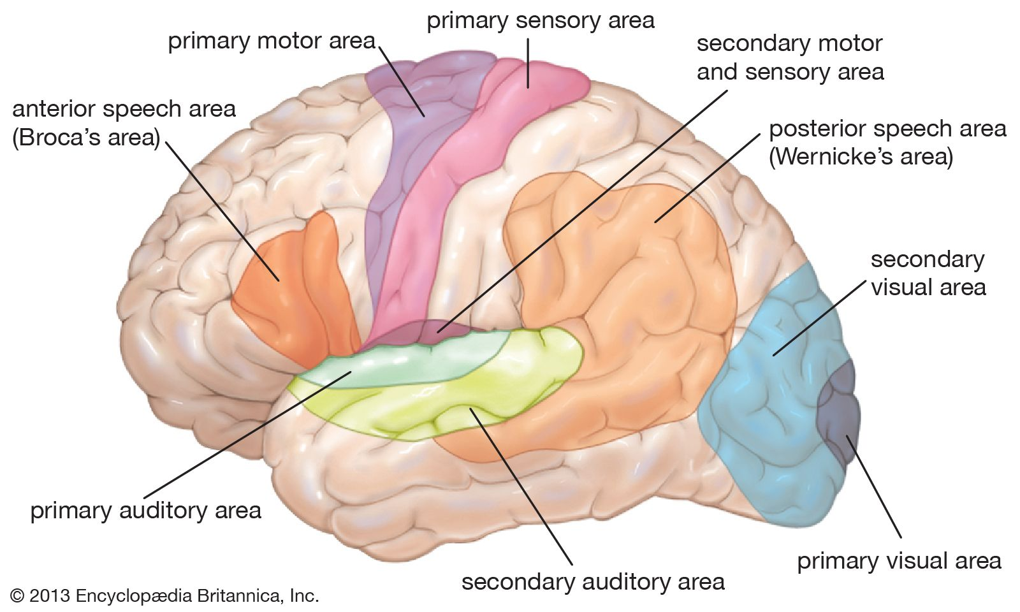
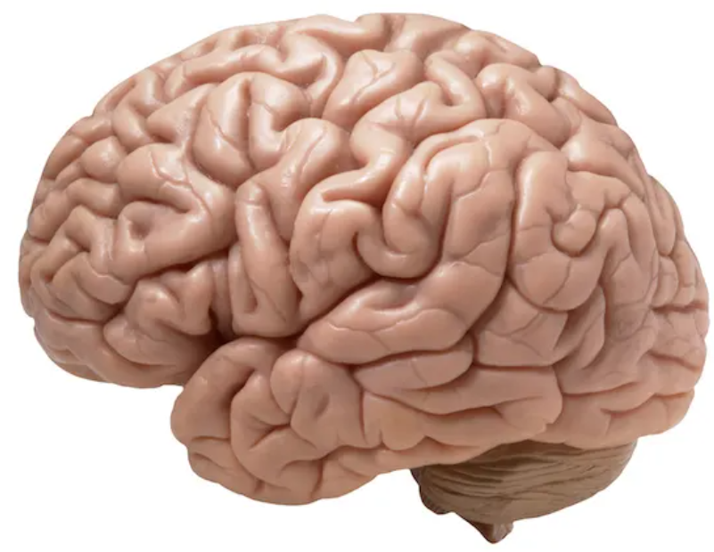
Human brain
Human activity is regulated by a nervous system:
Central nervous system
Brain
Spinal cord
Peripheral nervous system
≈ 10¹⁰ neurons in the brain
≈ 10⁴ synapses per neuron
≈ 1 ms processing speed of a neuron
Slow rate of operation
Extrem number of processing units & interconnections
Massive parallelism
Notes:
Image source: https://www.wired.com/2014/07/everything-you-need-to-know-about-the-10-brain-myth-explained-in-60-seconds/
Image source: ttps://www.britannica.com/science/human-nervous-system/Lobes-of-the-cerebral-cortex

Slide 12
Structural organization of brain
Molecules & Ions ................
Synapses ............................
Neural microcircuits ..........
Dendritic trees ....................
Neurons ...............................
Local circuits .......................
Interregional circuits ..........
Central nervous system .....
transmitters
fundamental organization level
assembly of synapses organized into patterns of
subunits of individual neurons
basic processing unit, size: 100 μm
localized regions in the brain, size: 1 mm
pathways, topographic maps
final level of complexity
connectivity to produce desired functions

Slide 13
1.4 Artificial neural networks
Neuron model
Network of neurons

Slide 14
What NN can do?
In principle
NN can compute any computable function (everything a normal digital computer can do)
In practice
NN are especially useful for classification and function approximation problems which are tolerant of some imprecision
Almost any finite-dimensional vector function on a compact set can be approximated to arbitrary precision by feedforward NN
Need a lot of training data
Difficulties to apply hard rules (such as those used in an expert system)
Problems difficult for NN
Predicting random or pseudo-random numbers
Factoring large integers
Determining whether a large integer is prime or composite
Decrypting anything encrypted by a good algorithm

Slide 15
1.5 Benefits of neural networks
Ability to learn from examples
Train neural network on training data
Neural network will generalize on new data
Noise tolerant
Many learning paradigms
Supervised (with a teacher)
Unsupervised (no teacher, self-organized)
Reinforcement learning
Adaptivity
Neural networks have a natural capability to adapt to the changing environment
Train neural network, then retrain
Continuous adaptation in a nonstationary environment

Slide 16
Benefits of neural networks
Nonlinearity
Artificial neurons can be linear or nonlinear
Network of nonlinear neurons has nonlinearity distributed throughout the network
Important for modeling inherently nonlinear signals
Fault tolerance
Capable of robust computation
Graceful degradation rather than catastrophic failure

Slide 17
Benefits of neural networks
Massively parallel distributed structure
Well suited for VLSI implementation
Very fast hardware operation
Neurobiological analogy
NN design is motivated by analogy with brain
NN are a research tool for neurobiologists
Neurobiology inspires further development of artificial NN
Uniformity of analysis & design
Neurons represent the building blocks of all neural networks
Similar NN architecture for various tasks: pattern recognition, regression, time series forecasting, control applications, ...

Slide 18
1.6 Brief history of neural networks
-1940 von Helmholtz, Mach, Pavlov, etc.
– General theories of learning, vision, conditioning
– No specific mathematical models of neuron operation
1943 McCulloch and Pitts – Proposed the neuron model
1949 Hebb
– Published his book The Organization of Behavior
– Introduced the Hebbian learning rule
1958 Rosenblatt, Widrow and Hoff – Perceptron, ADALINE
– First practical networks and learning rules
1969 Minsky and Papert
– Published book Perceptrons, generalized the limitations of single-layer perceptrons to multilayered systems
– Neural Network field went into hibernation

Slide 19
Brief history of neural networks
1974 Werbos – Developed back-propagation learning method in his PhD thesis
– Several years passed before this approach was popularized
1982 Hopfield – Published a series of papers on Hopfield networks
1982 Kohonen – Developed the Self-Organising Maps
1980s Rumelhart and McClelland – Backpropagation rediscovered, re-emergence of neural networks field
– Books, conferences, courses, funding in USA, Europe, Japan
1990s Radial Basis Function Networks were developed
2000s The power of Ensembles of Neural Networks and Support Vector Machines becomes apparent
Notes:
https://en.wikipedia.org/wiki/History_of_artificial_neural_networks

Slide 20
Brief history of neural networks
2000s Hardware-based designs – CMOS computational devices: biophysical simulation & neuromorphic computing
– Nanodevices for very large-scale principal components analyses and convolution
– GPU-based backpropagation for multi-layered feedforward neural networks
2010s Convolutional neural networks and deep learning
– Rapid evolution of deep learning methods
– Convolutional layers and max-pooling layers become the state of the art
– Deep learning methods achieve human-competitive performance on certain practical applications
2017 Alfa Zero – Superhuman performance in three information perfect games (go, chess, shogi) using the rules of the game and a single algorithm for all games
2020 Mu Zero – Superhuman performance in four information perfect games (go, chess, shogi, atari) without knowing the rules of the games (mastering unknown dynamics)
Notes:
https://en.wikipedia.org/wiki/History_of_artificial_neural_networks
https://www.nature.com/articles/s41586-020-03051-4

Slide 21
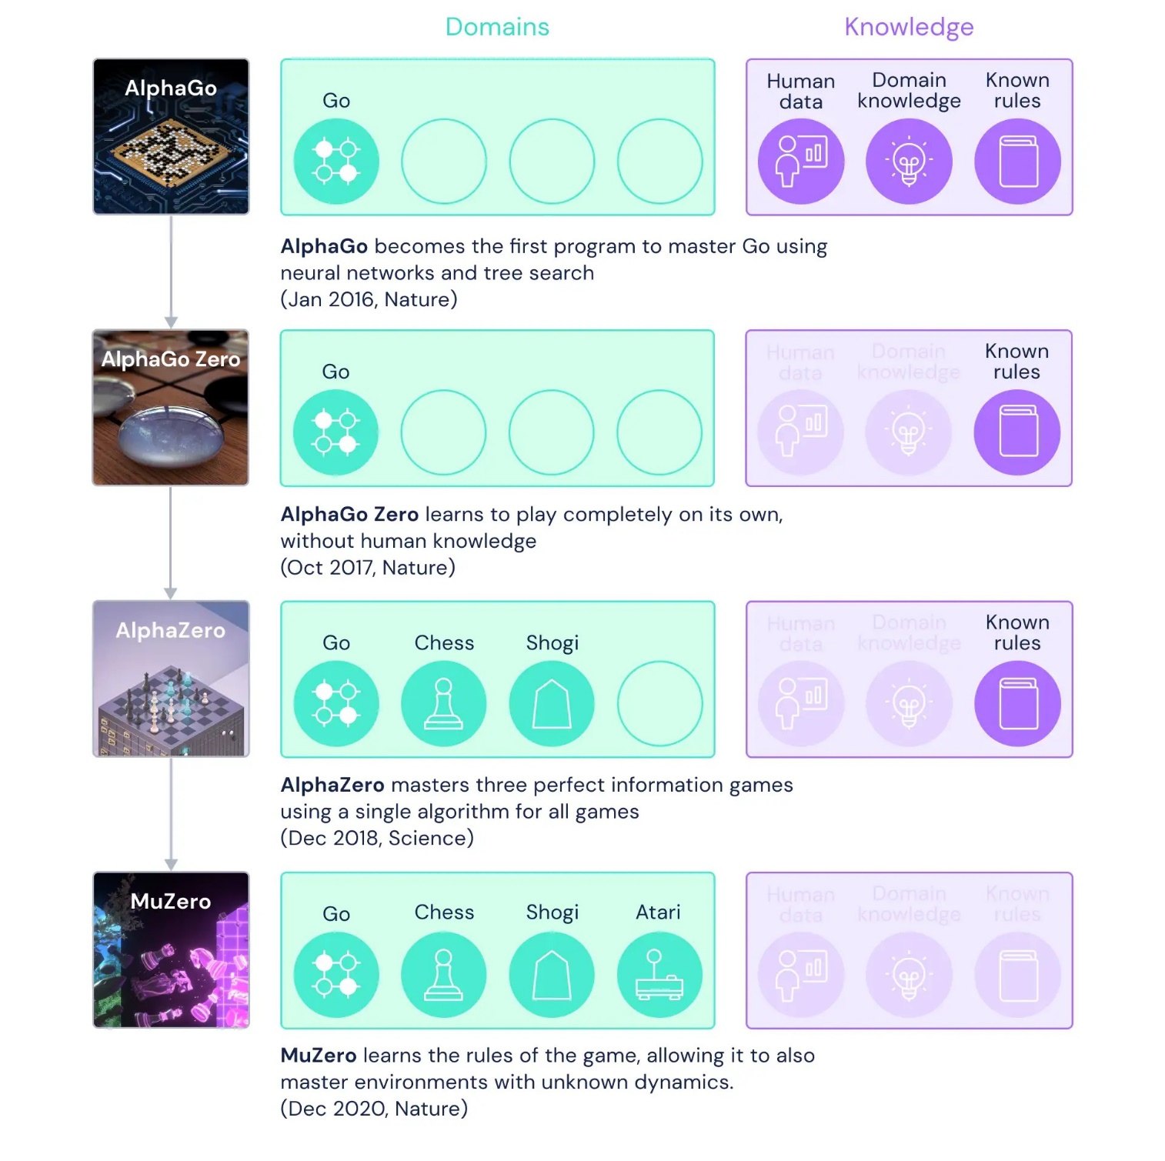
Notes:
https://deepmind.com/blog/article/muzero-mastering-go-chess-shogi-and-atari-without-rules

Slide 22
1.7 Applications of neural networks
Aerospace
High-performance aircraft autopilots, flight path simulations, aircraft control systems, autopilot enhancements, aircraft component simulations, aircraft component fault detectors
Automotive
Automobile automatic guidance systems, warranty activity analyzers
Banking
Check and other document readers, credit application evaluators
Defense
Weapon steering, target tracking, object discrimination, facial recognition, new kinds of sensors, sonar, radar and image signal processing including data compression, feature extraction and noise suppression, signal/image identification
Electronics
Code sequence prediction, integrated circuit chip layout, process control, chip failure analysis, machine vision, voice synthesis, nonlinear modeling

Slide 23
Applications of neural networks
Financial
Real estate appraisal, loan advisor, corporate bond rating, credit line use analysis, portfolio trading program, corporate financial analysis, currency price prediction
Manufacturing
Manufacturing process control, product design and analysis, process and machine diagnosis, real-time particle identification, visual quality inspection systems, welding quality analysis, paper quality prediction, computer chip quality analysis, analysis of grinding operations, chemical product design analysis, machine maintenance analysis, project planning and management, dynamic modeling of chemical process systems
Medical
Breast cancer cell analysis, EEG and ECG analysis, prothesis design, optimization of transplant times, hospital expense reduction, hospital quality improvement, emergency room test advisement

Slide 24
Applications of neural networks
Robotics
Trajectory control, forklift robot, manipulator controllers, vision systems
Speech
Speech recognition, speech compression, vowel classification, text-to-speech synthesis
Securities
Market analysis, automatic bond rating, stock trading advisory systems
Telecommunications
Image and data compression, automated information services, real-time translation of spoken language, customer payment processing systems
Transportation
Truck brake diagnosis systems, vehicle scheduling, routing systems

